Slide 1

Interfacing LED, Switch and Buzzer with LPC4088
DAY 17
EMBEDDED SYSTEM DESIGN & IoT-Master Class

Slide 2
What You will learn Today?
Registers
LED Blinking
Switch
Buzzer Interface

Slide 3
Mindset Lesson for the Day
Knowing and not doing is not Knowing.
Take Action.

Slide 4
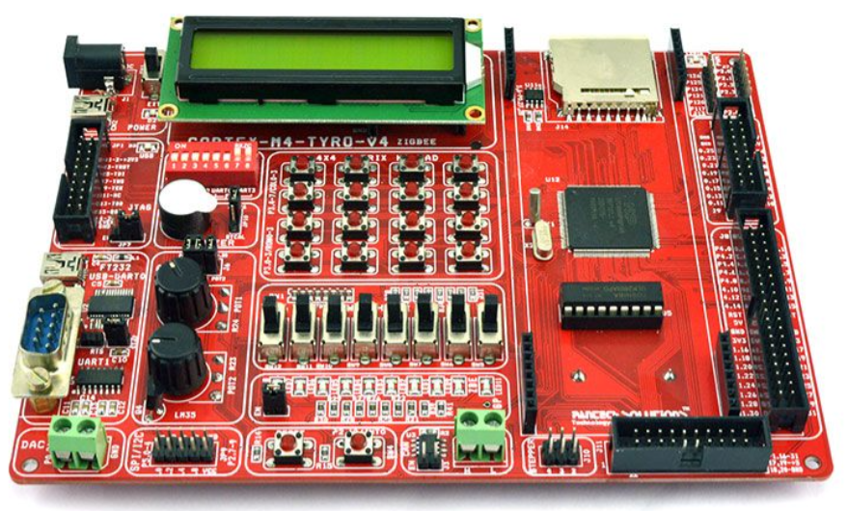
Embedded Sytem Design using Cortex M4-LPC4088

Slide 5
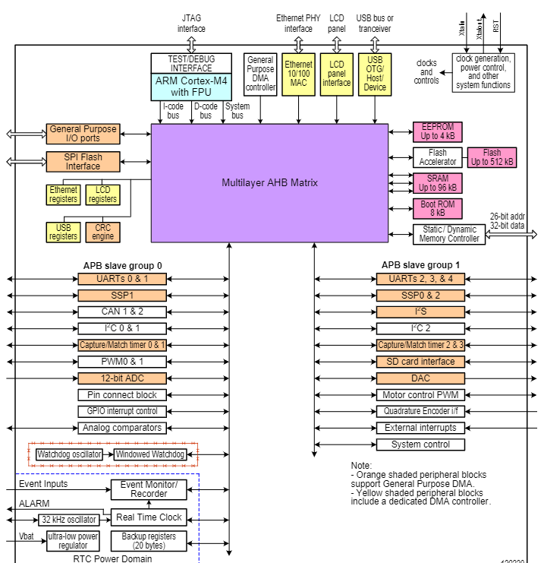
LPC4088 BLOCK DIAGRAM

Slide 6
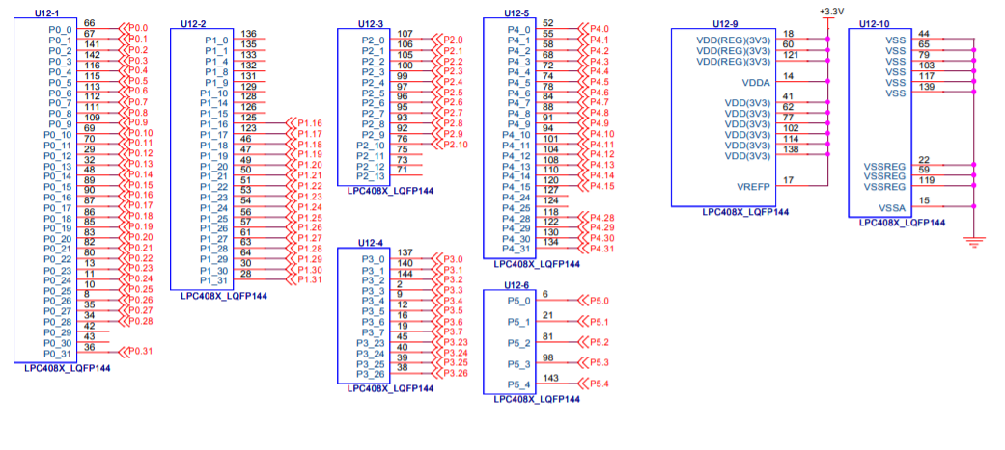
LPC4088

Slide 7
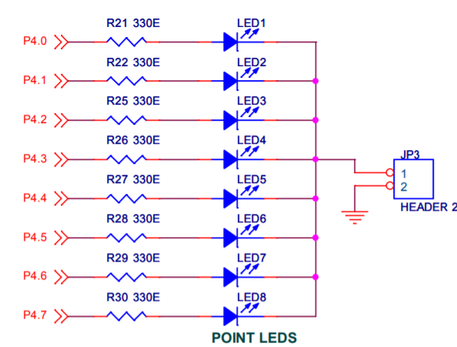
LED Interface

Slide 8
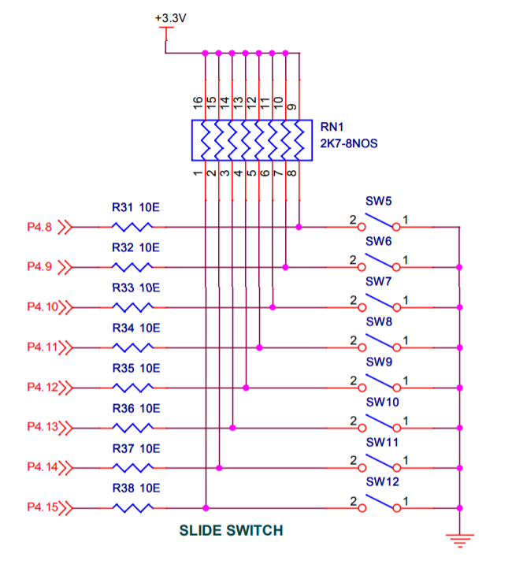
Slide Switch Interface

Slide 9
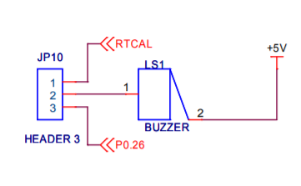
Buzzer Interface

Slide 10
Registers

Slide 11
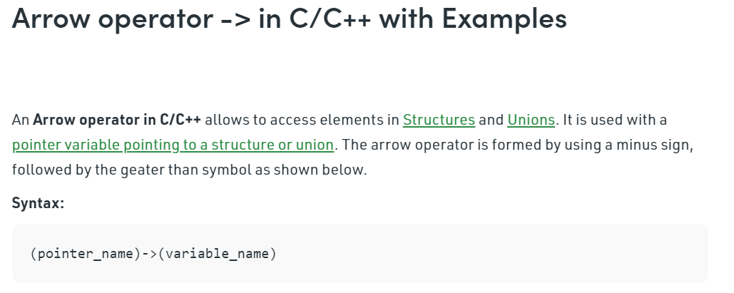

Slide 12
LED Blinking demo
#include "LPC407x_8x_177x_8x.h"
void delay_ms(long ms);
int main(void)
{
//1. Set the PCGPIO bit
LPC_SC->PCONP |= (1<<15);
//2. Configure pins P4.0 to P4.7 as GPIO pins
LPC_IOCON->P4_0 = 0;
LPC_IOCON->P4_1 = 0;
LPC_IOCON->P4_2 = 0;
LPC_IOCON->P4_3 = 0;
LPC_IOCON->P4_4 = 0;
LPC_IOCON->P4_5 = 0;
LPC_IOCON->P4_6 = 0;
LPC_IOCON->P4_7 = 0;
//3. Configure the pins P4.0 to P4.7 as output
LPC_GPIO4->DIR= 0xFF;
while(1)
{
//4. Send a High
LPC_GPIO4->PIN= 0xFF;
//5.Pause the system for few milliseconds
delay_ms(500);
//6.Send a low
LPC_GPIO4->PIN= 0x00;
//7.Pause the system for few milliseconds
delay_ms(500);
}
}

Slide 13
Delay
void delay_ms(long ms) // delay 1 ms per count @ CCLK 120 MHz
{
long i,j;
for (i = 0; i < ms; i++ )
for (j = 0; j < 26659; j++ );
}

Slide 14
#include "LPC407x_8x_177x_8x.h"
void delay_ms(long ms);
int main(void)
{
//1. Set the PCGPIO bit
LPC_SC->PCONP |= (1<<15);
//2. Configure pins P4.0 to P4.15 as GPIO pins
LPC_IOCON->P4_0 = 0;
LPC_IOCON->P4_1 = 0;
LPC_IOCON->P4_2 = 0;
LPC_IOCON->P4_3 = 0;
LPC_IOCON->P4_4 = 0;
LPC_IOCON->P4_5 = 0;
LPC_IOCON->P4_6 = 0;
LPC_IOCON->P4_7 = 0;
LPC_IOCON->P4_8 = 0;
LPC_IOCON->P4_9 = 0;
LPC_IOCON->P4_10 = 0;
LPC_IOCON->P4_11 = 0;
LPC_IOCON->P4_12 = 0;
LPC_IOCON->P4_13 = 0;
LPC_IOCON->P4_14 = 0;
LPC_IOCON->P4_15 = 0;
//3. Configure the pins P4.0 to P4.7 as output
// SWITCH pins P4.8 to P4.15 as input
LPC_GPIO4->DIR= 0x00FF;
while(1)
{
//4. Read the Switch Status and display it in LEDs
LPC_GPIO4->PIN >>= 8;
delay_ms(50);
}
}

Slide 15
void delay_ms(long ms) // delay 1 ms per count @ CCLK 120 MHz
{
long i,j;
for (i = 0; i < ms; i++ )
for (j = 0; j < 26659; j++ );
}

Slide 16
Thank You

